Slide 1
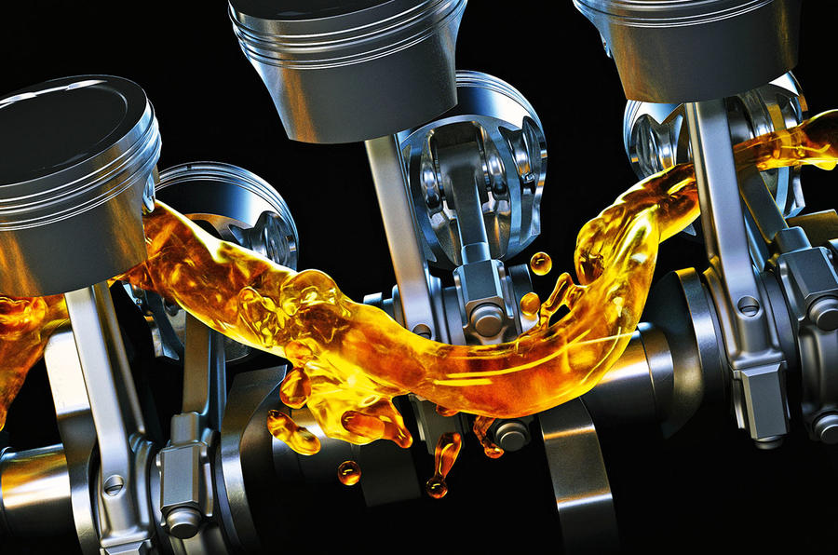
Computer- Based Inventory Management System for Galle Auto Parts Shop.
SMKTS BANDARA
E2046014

Slide 2


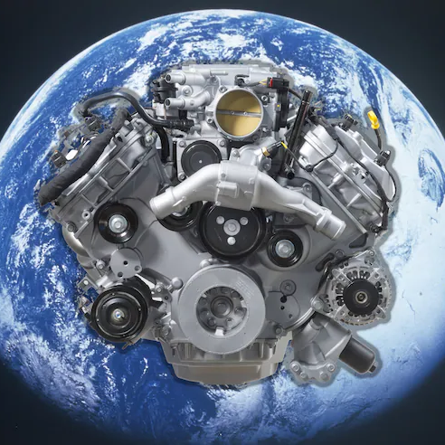
Agenda
INTRODUCTION
RELATED WORK
SYSTEM ANALYSIS
SYSTEM DESIGN
SYSTEM IMPLEMENTATION
REPORT

Slide 3
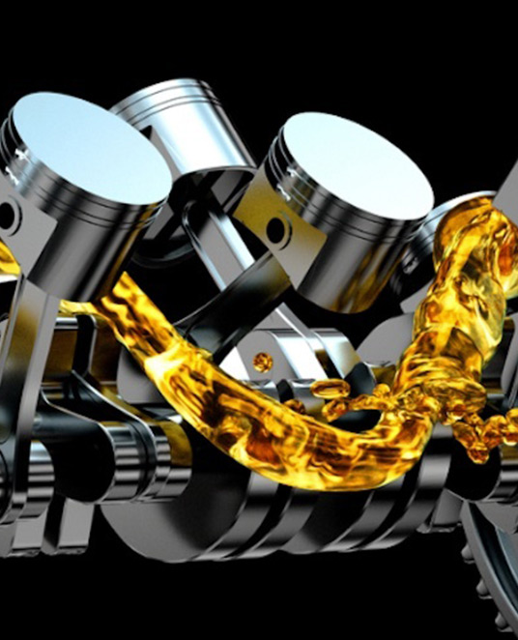
Introduction
We have created a computer-based inventory management system for the Galle auto parts shop which has a manual system. By comparison, we realized that it was a very advantageous methodology.

Slide 4
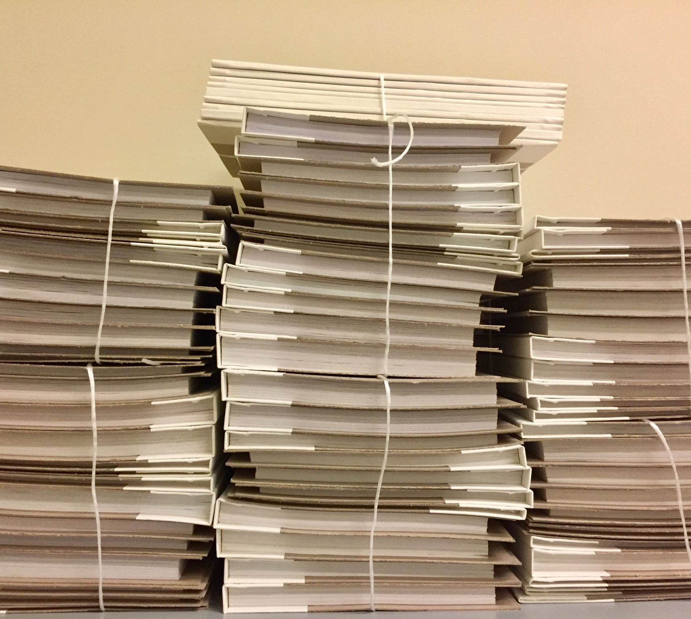
Problem In Brief
There are so many errors in daily transactions.
Without checking it is difficult to look for available and unavailable stock.
There are so many errors in bills. In the manual system.
The books and the papers lose and misplace.
There’s a possibility to forget to record the transaction.
Sometimes they forget to write the transactions

Slide 5


AIM
Aim of this project is to design and develop a computer – based Inventory Management System for Galle Auto Parts Shop.
OBJECTIVES
All the transactions will be computerized.
Can check the monthly income.
Can keep a backup.
Can check the available stocks and sold- out stocks.
Can look for items that are highly sold.

Slide 6
RELATED WORK
Features | Manual System | Proposed System | Auto Lanka Advertising & marketing (Pvt) Ltd | Douglas & Sons(Pvt) Ltd | Grease Monkey Auto mobile parts | OEM | Euro Car Parts | Care Distributers
 |  | Local |  |  |  |  | Foreign
Flexible | No | Yes | No | No | Yes | Yes | No | No
Users | No | Yes | Yes | Yes | No | No | Yes | Yes
Categories | No | Yes | Yes | Yes | Yes | Yes | Yes | Yes
Search items | No | Yes | Yes | Yes | Yes | Yes | No | Yes
Brands | No | Yes | Yes | No | Yes | Yes | Yes | Yes
Supplier Reg | No | Yes | No | No | No | No | Yes | Yes
Delivery | Yes | No | No | No | No | No | No | Yes

Slide 7
SYSTEM ANALYSIS
Functional Requirements
User Registration
Add User
Edit User
Delete User
Product Management
Add product
Edit Product
Delete product
Category Management
Add Category
Edit Category
Delete Category
Add Brand
Edit Brand
Sample Footer Text

Slide 8
NON-FUNCTIONAL REQUIREMENTS
Requirements for performance
The system must process events at an acceptable rate to allow the user to browse quickly.
Requirements for usability
When the site is loaded, it should be dispersed among many servers to avoid a large release log.
Requirements for the User Interface
The user interfaces must have recognized functions. The text in the user interface should be comprehensible and regain proper meaning.

Slide 9
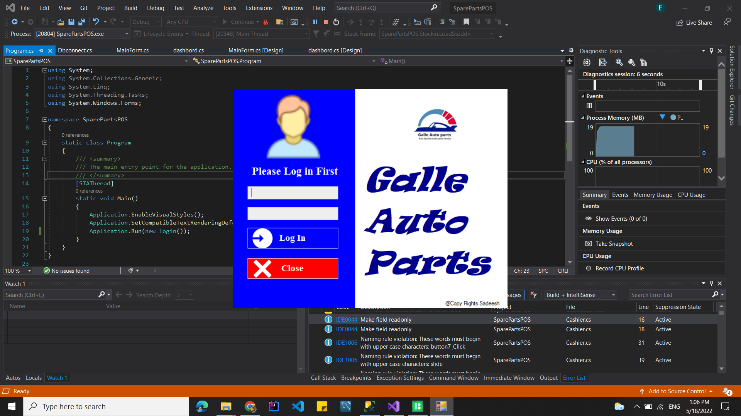
SYSTEM DESIGN
Log In Design
Sample Footer Text

Slide 10
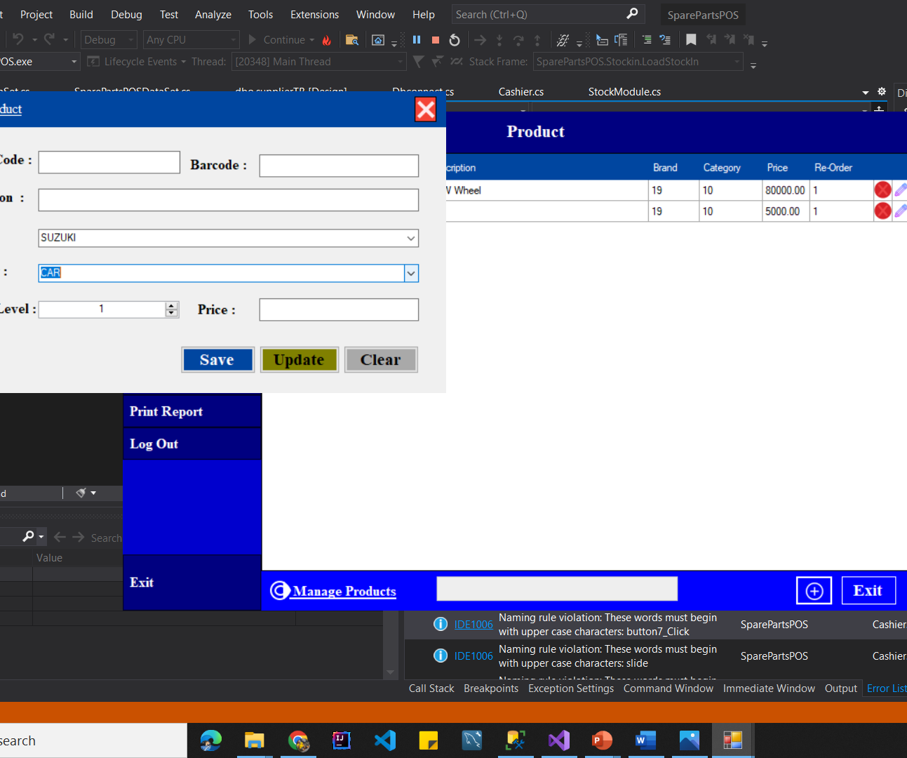
Product Management Design

Slide 11
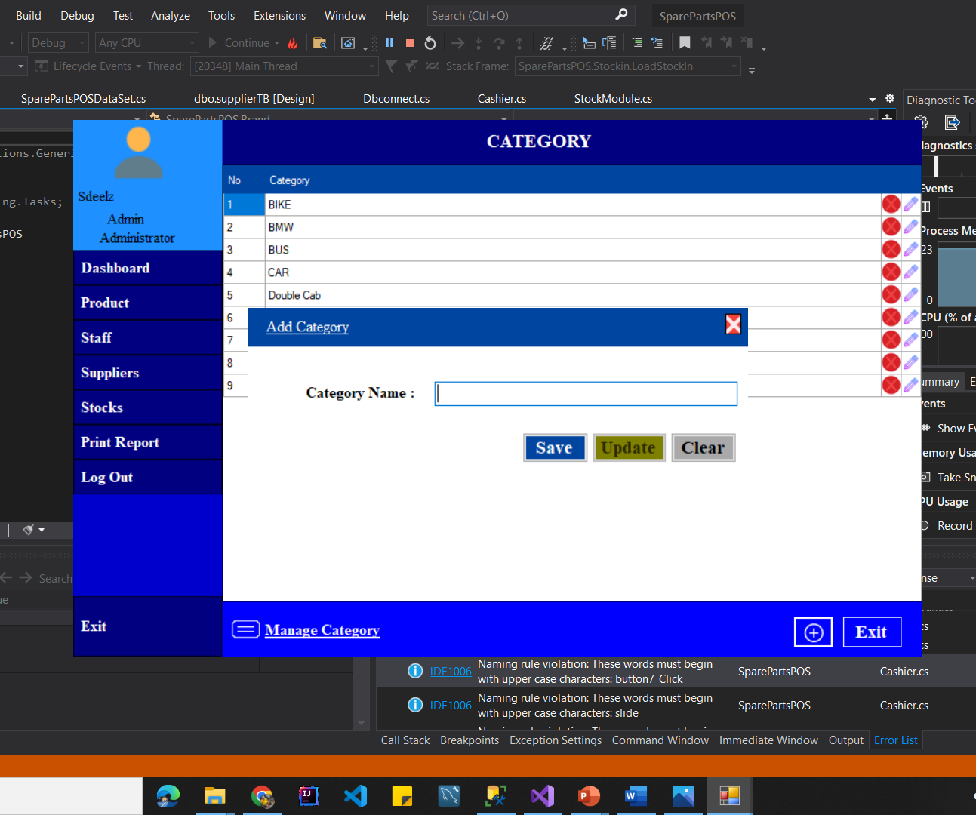
Category management
Design

Slide 12
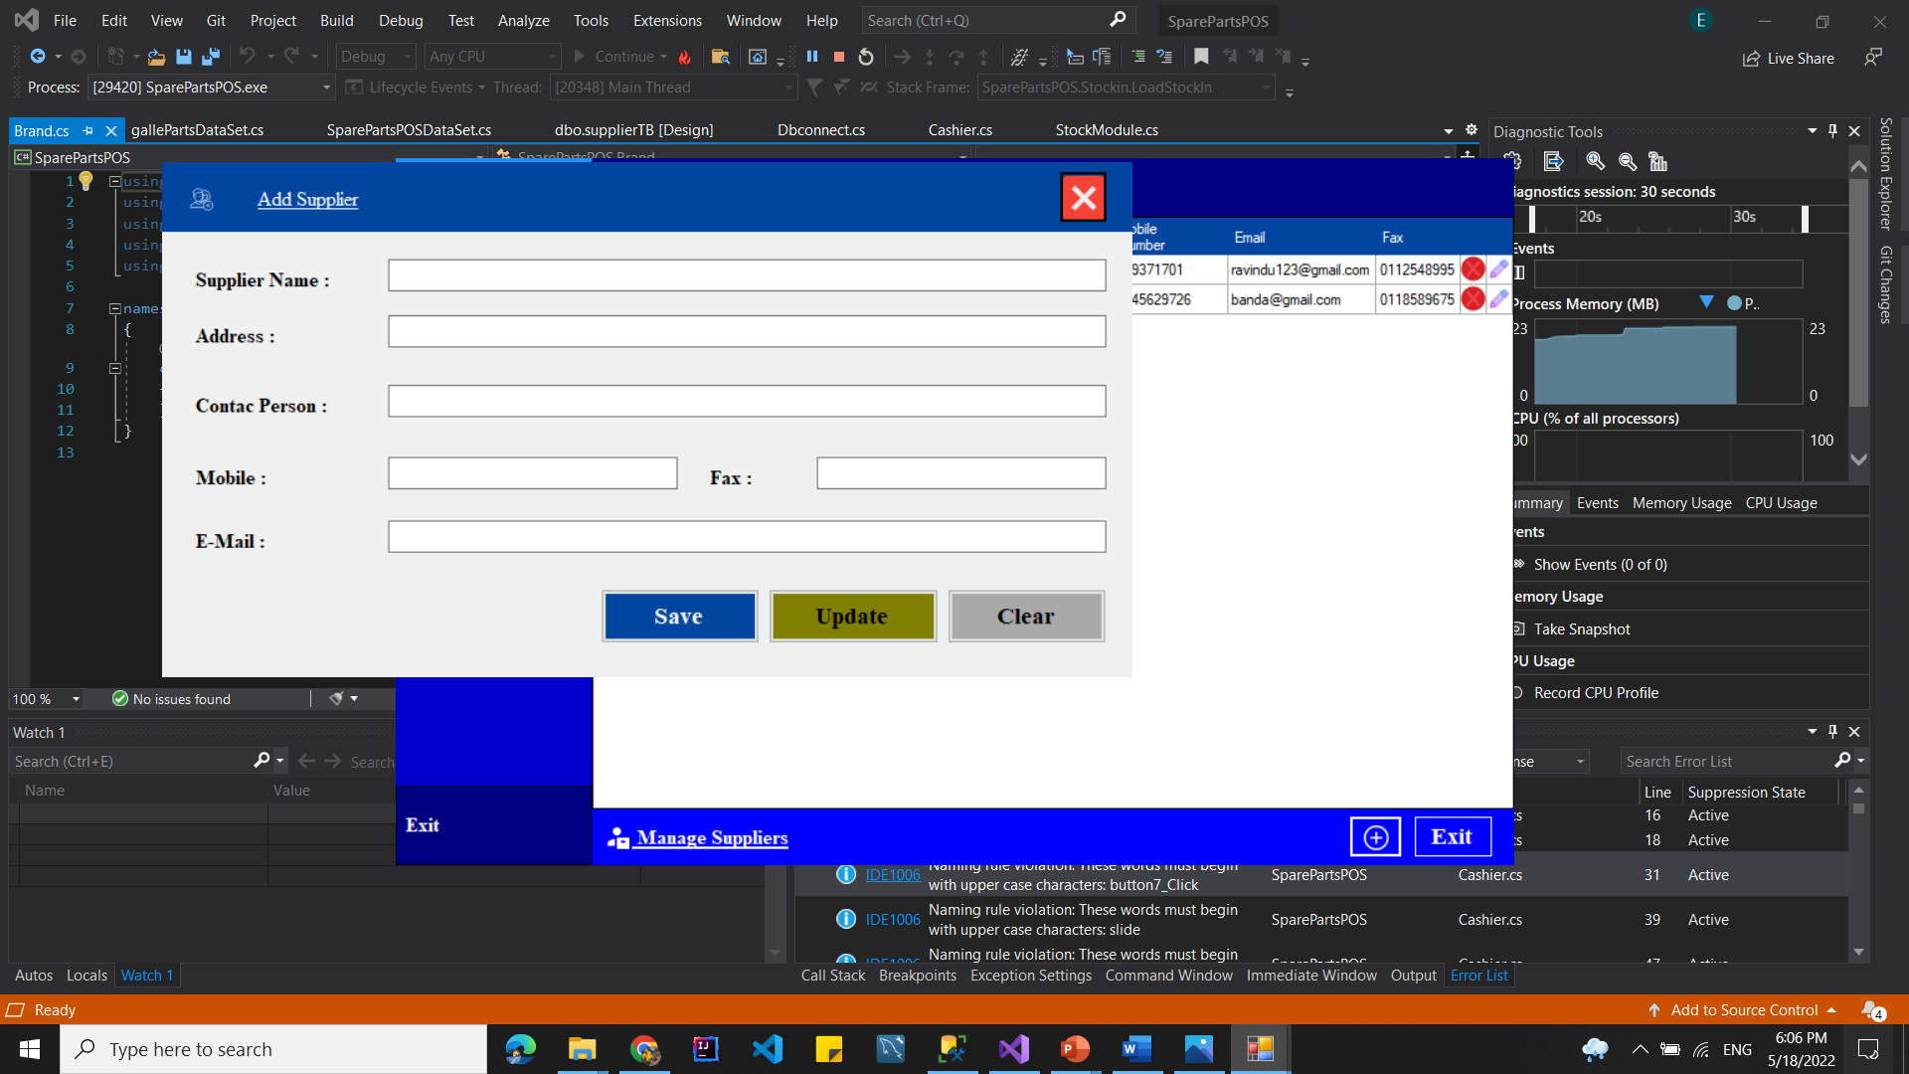
Supplier management
Design

Slide 13
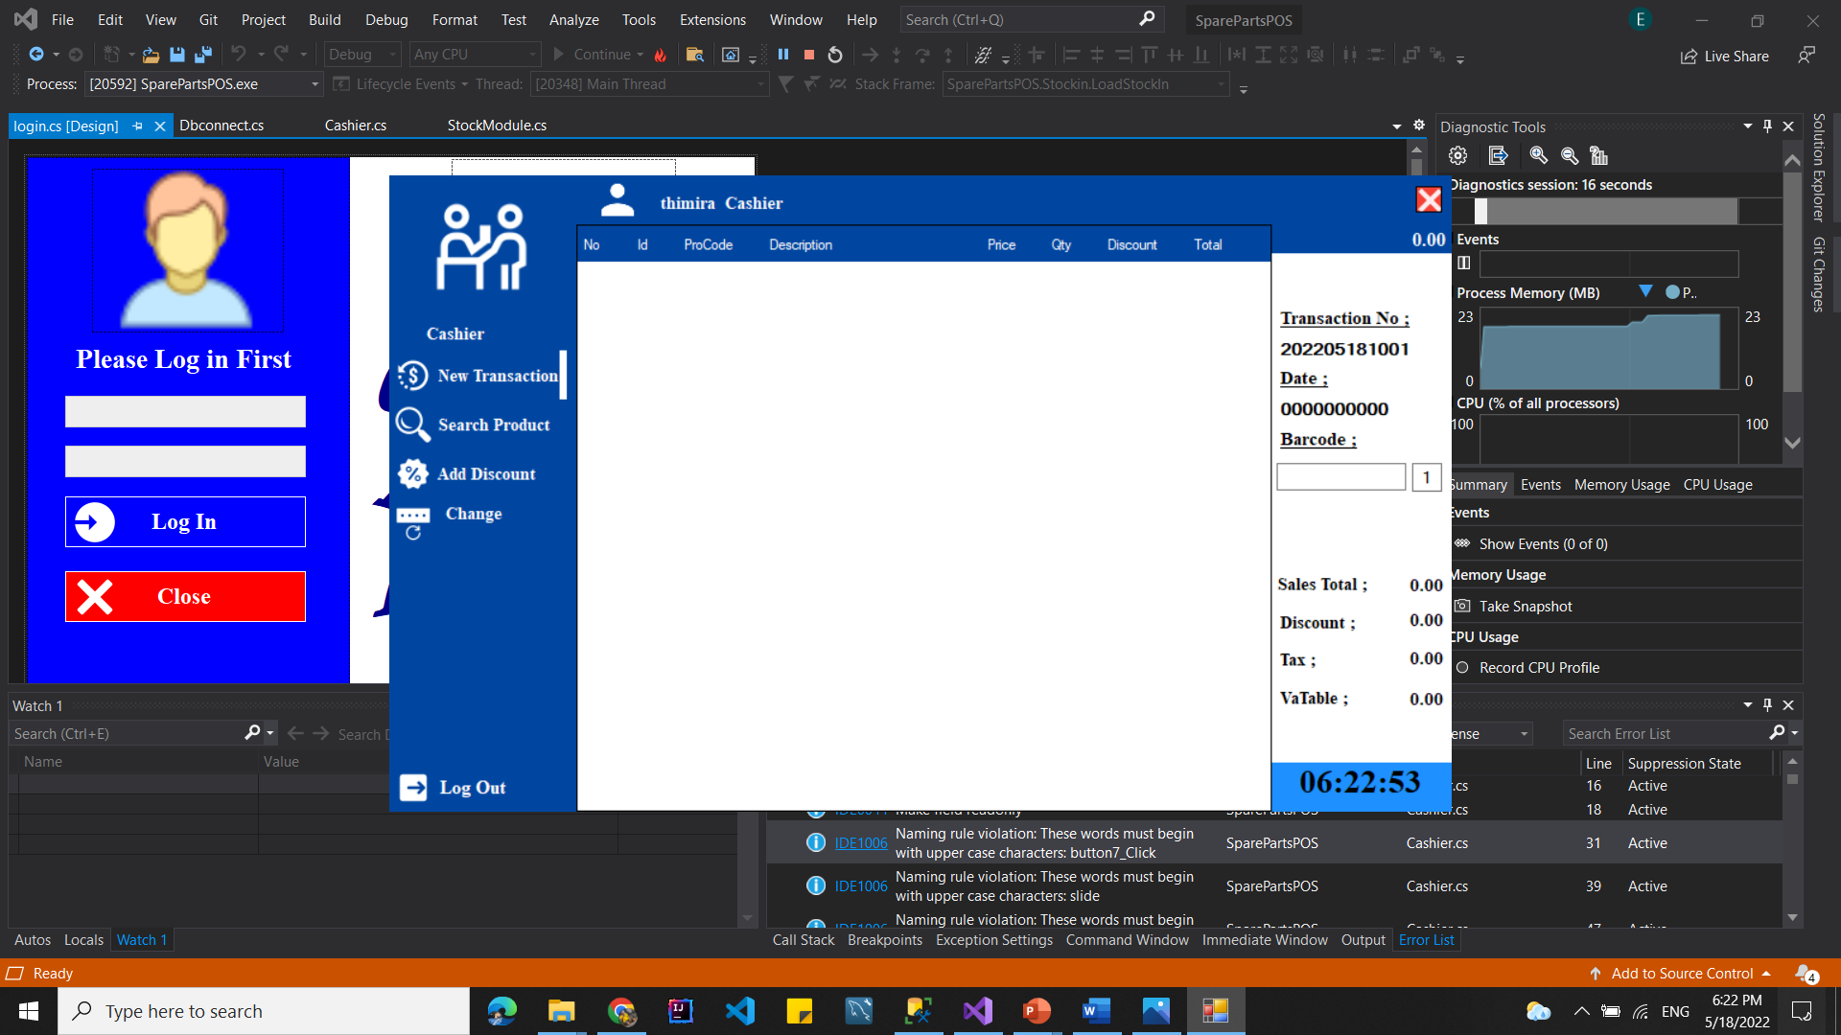
Cashier Design

Slide 14
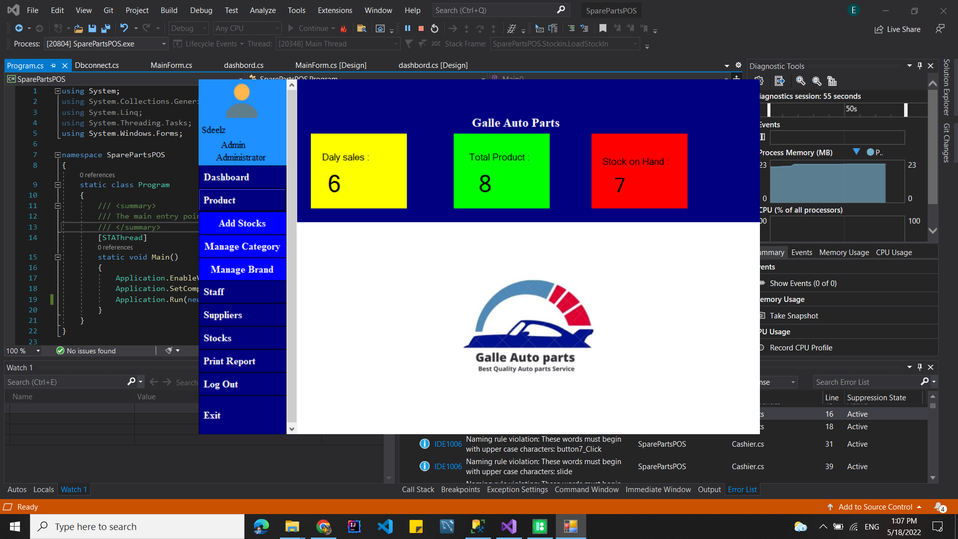
Reports

Slide 15
Reference
"Auto lanka Advertising & Marketing (pvt) ltd," Auto lanka Advertising & Marketing (pvt) ltd, [Online]. Available: https://www.auto-lanka.com/. [Accessed 24 02 2022].
“Douglas & Sons (pvt) ltd," Douglas & Sons (pvt) ltd, [Online]. Available: https://www.dsl-autoparts.com/. [Accessed 25 02 2022].
"Grease Monkey .lk," Grease Monkey, [Online]. Available: https://greasemonkey.lk/. [Accessed 25 02 2022].
“Original Equipment manufacturer(OEM)," Original Equipment manufacturer, [Online]. Available: https://oemparts.lk/. [Accessed 25 02 2022].
"Euro Car Parts," Euro Car Parts, [Online]. Available: https://www.eurocarparts.com/. [Accessed 25 02 2022].
“Care Distributers," Care Distributers, [Online]. Available: https://caredistributors.com.au/categories/polishes-compounds.html?gclid=Cj0KCQiAmeKQBhDvARIsAHJ7mF4buy1PanpFhRMZF04Z7oHkI6xZ8-rQFPLd7SHqznS5qZxE2bCIv4kaAvL4EALw_wcB. [Accessed 25 02 2022].
Sample Footer Text

Slide 16

Thank You
Bandara SMKTS
E2046014

